Slide 1
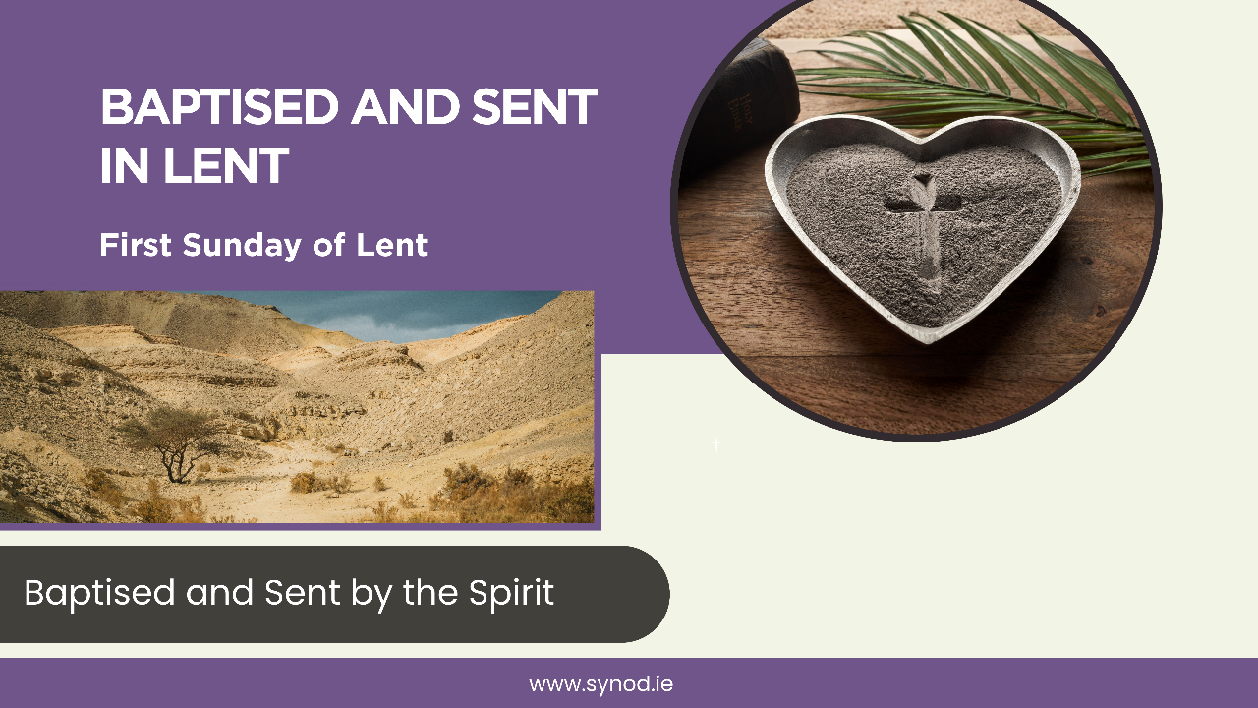

Slide 2

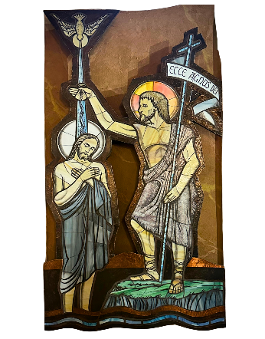
Opening Prayer
Loving God,
You call us to renew our baptism
during this season of Lent as we journey to Easter.
Help us to respond more fully to Your call and send us out to proclaim the Gospel by our lives.
Through Christ Our Lord.
Amen.

Slide 3
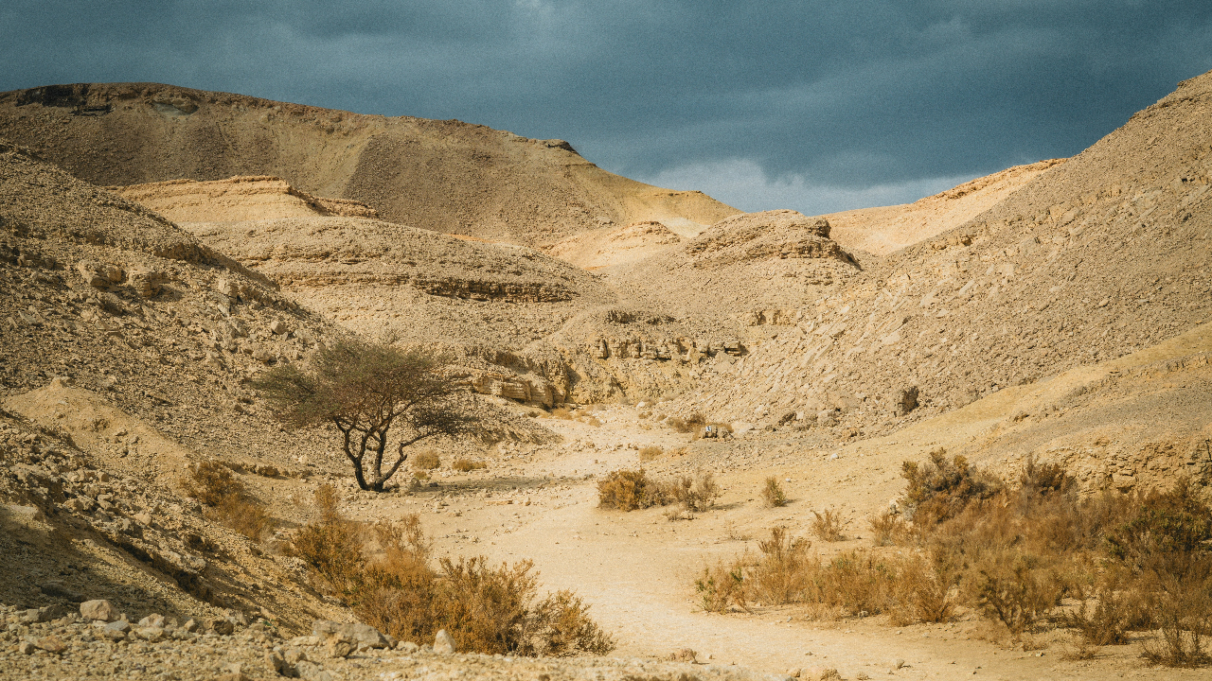
Read Gospel and Passages from Baptised and Sent
Matthew 4:1-11 The Temptation in the Wilderness

Slide 4
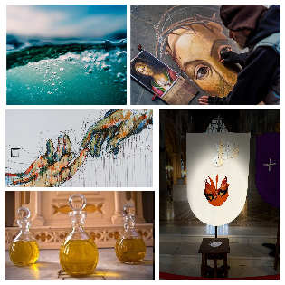
Reflect
Pause for silent reflection.
Share what is staying with you from these readings.
Listen to each other to understand.
In what way is the Holy Spirit leading me and us in our Lenten synodal journey?
Make sure everyone gets a chance to share their thoughts

Slide 5
Respond in Action
Having listened to what each person has to say and decided on where the Holy Spirit is leading you on your Lenten journey now consider the following question:
What concrete action or steps can I/we take to respond more fully to our Baptism?
Find ways to realise these action points in your life and community.

Slide 6
Closing Prayer
Gracious God,
We thank you for journeying with us and for all that has been shared.
Help us to remember that we are all Baptised and Sent and give us the courage and energy to make a difference in our world.
Through Christ our Lord.
Amen.

Slide 7
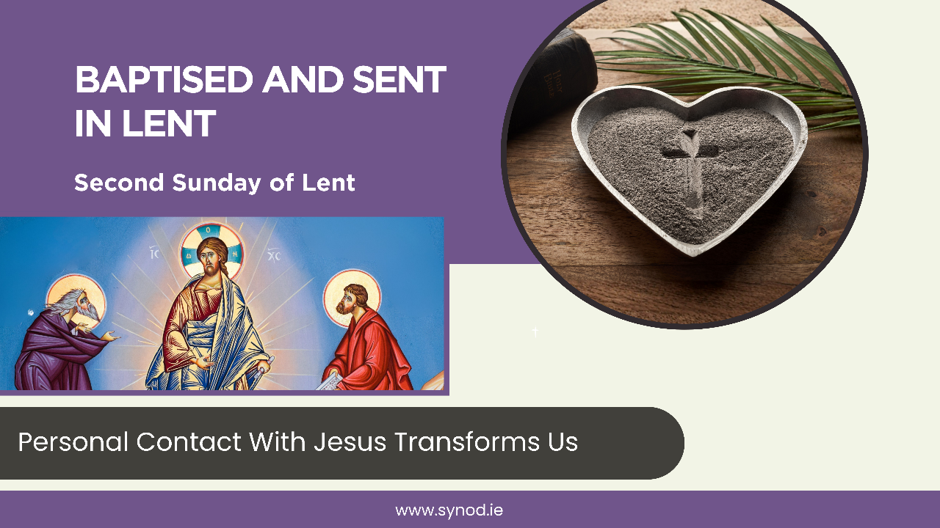

Slide 8
Opening Prayer
Loving God,
You call us to renew our baptism
during this season of Lent as we journey to Easter.
Help us to respond more fully to Your call and send us out to proclaim the Gospel by our lives,
Through Christ Our Lord.
Amen.

Slide 9
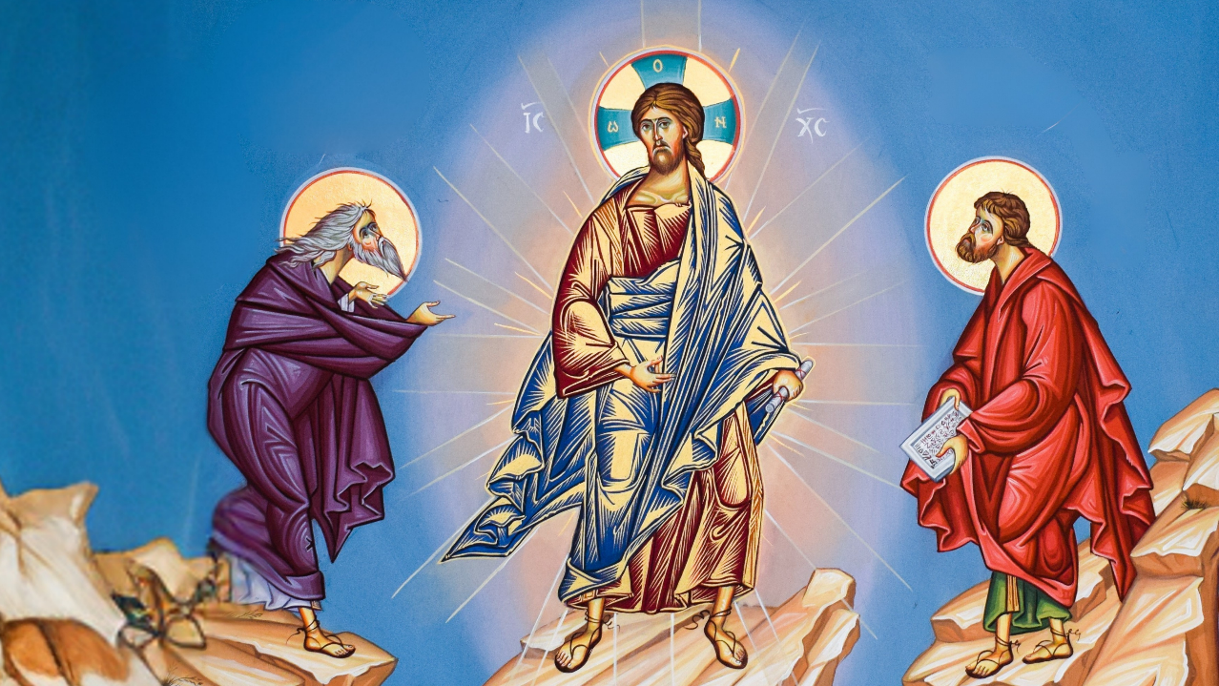
Read Gospel Passages and Two passages from Baptised and Sent
Matthew 17:1-9 The Transfiguration

Slide 10
Reflect
Pause for silent reflection.
Share what is staying with you from these readings.
Listen to each other to understand.
In what way/s is faith formation a priority for you, your family and your parish?
Make sure everyone gets a chance to share their thoughts

Slide 11
Respond in Action
Having listened to what each person has to say and decided on what way/s is faith formation a priority for you, your family and your parish, consider the following question:
What concrete actions or steps can I/we take to make faith formation a priority?
Find ways to realise these action points in your life and community.

Slide 12
Closing Prayer
Gracious God,
We thank you for journeying with us and for all that has been shared.
Help us to remember that we are all Baptised and Sent and give us the courage and energy to make a difference in our world.
Through Christ our Lord.
Amen.

Slide 13
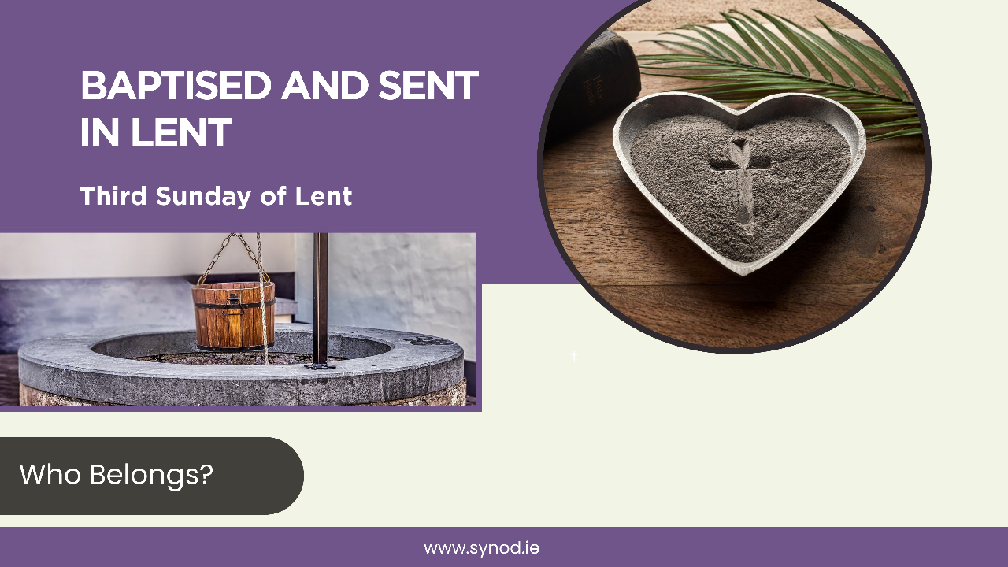

Slide 14
Opening Prayer
Loving God,
You call us to renew our baptism
during this season of Lent as we journey to Easter.
Help us to respond more fully to Your call and send us out to proclaim the Gospel by our lives.
Through Christ Our Lord.
Amen.

Slide 15
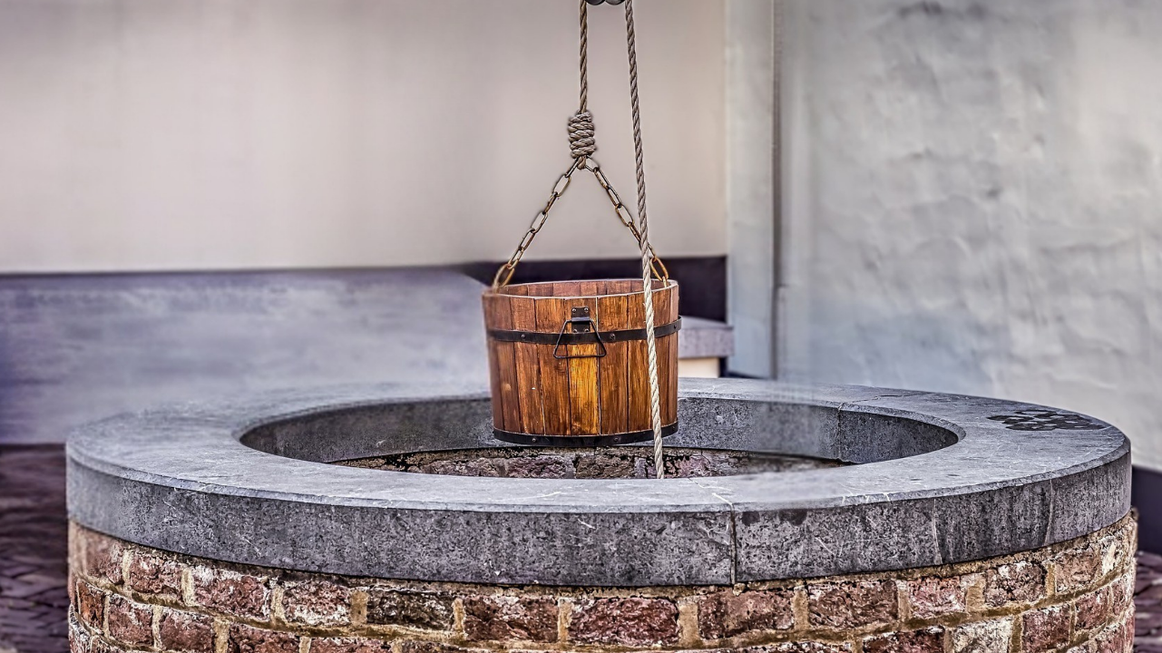
Read Gospel and Passages from Baptised and Sent
John 4:5-16,​19-26,​39-42 Jesus and the Samaritan Woman at the Well

Slide 16
Reflect
Pause for silent reflection.
Share what is staying with you from these readings.
Listen to each other to understand.
In what way/s is your parish welcoming and inclusive?
Make sure everyone gets a chance to share their thoughts

Slide 17
Respond in Action
Having listened to what each person has to say and decided on what what way/s is your parish welcoming and inclusive, consider the following question:
What concrete action or steps can I/we take to help more people feel that they belong?
Find ways to realise these action points in your life and community.

Slide 18
Closing Prayer
Gracious God,
We thank you for journeying with us and for all that has been shared.
Help us to remember that we are all Baptised and Sent and give us the courage and energy to make a difference in our world.
Through Christ our Lord
Amen

Slide 19
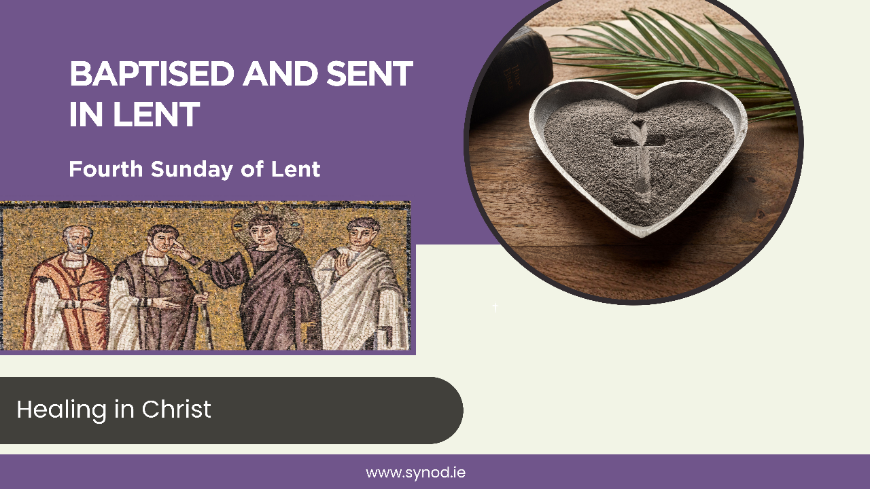
Notes:
Licence: Laurence Lew OP, Image of Jesus Healing
Blind Man, used under CC BY-NC-ND 2.0
https://www.flickr.com/photos/paullew/1263354134
5/in/photostream/

Slide 20
Opening Prayer
Loving God,
You call us to renew our baptism
during this season of Lent as we journey to Easter.
Help us to respond more fully to Your call and send us out to proclaim the Gospel by our lives.
Through Christ Our Lord.
Amen

Slide 21
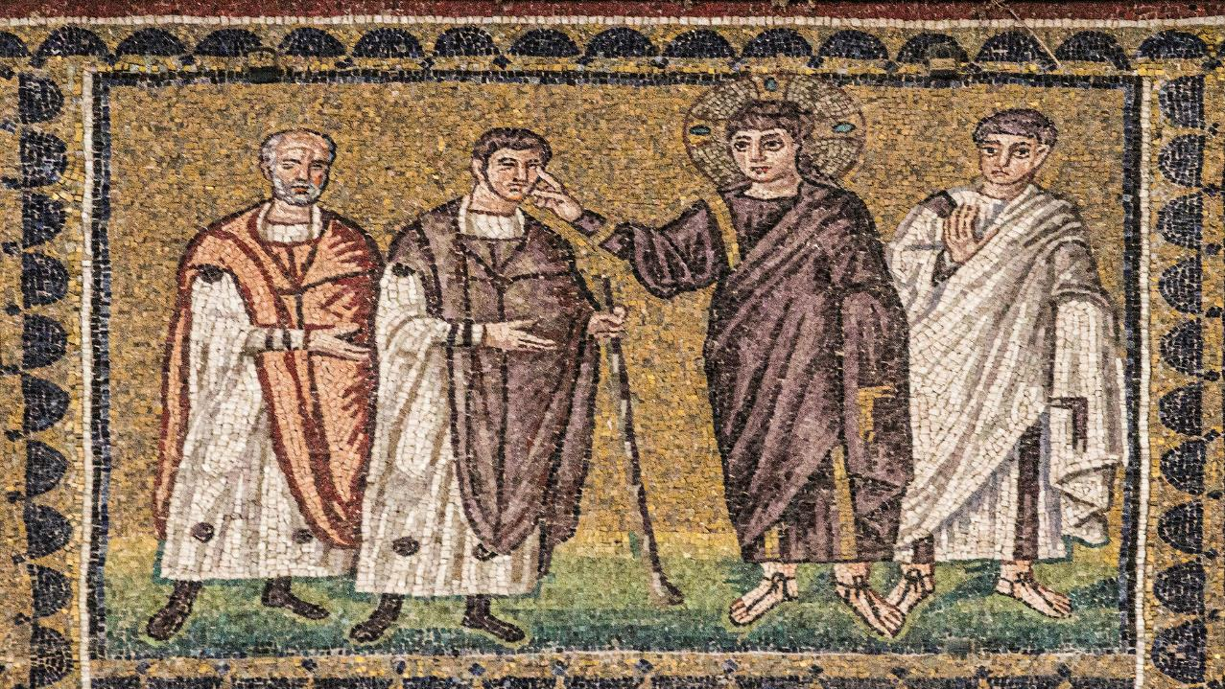
Read Gospel and Passages from Baptised and Sent
John 9:1,6-9,13-17,34-38 The Healing of the Man Born Blind

Slide 22
Reflect
Pause for silent reflection.
Share what is staying with you from these readings.
Listen to each other to understand.
How do people experience our parish community as a place where healing can happen?
Make sure everyone gets a chance to share their thoughts

Slide 23
Respond in Action
Having listened to what each person has to say and decided on what what way/s is your parish welcoming and inclusive, consider the following question:
What concrete action or steps can I/we take to reach out to those in need of healing?
Find ways to realise these action points in your life and community.

Slide 24
Closing Prayer
Gracious God,
We thank you for journeying with us and for all that has been shared.
Help us to remember that we are all Baptised and Sent and give us the courage and energy to make a difference in our world.
Through Christ our Lord
Amen

Slide 25
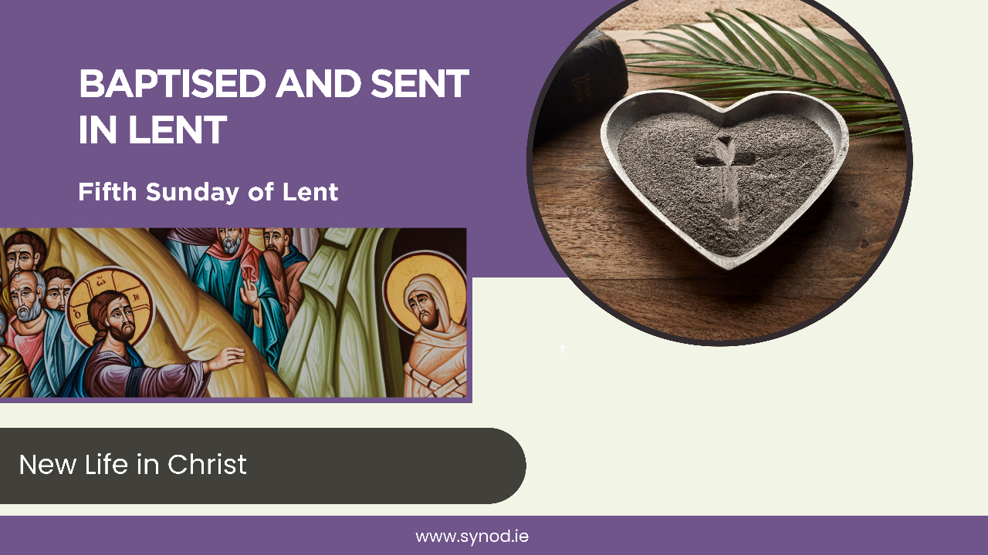

Slide 26
Opening Prayer
Loving God,
You call us to renew our baptism
during this season of Lent as we journey to Easter.
Help us to respond more fully to Your call and send us out to proclaim the Gospel by our lives.
Through Christ Our Lord.
Amen.

Slide 27
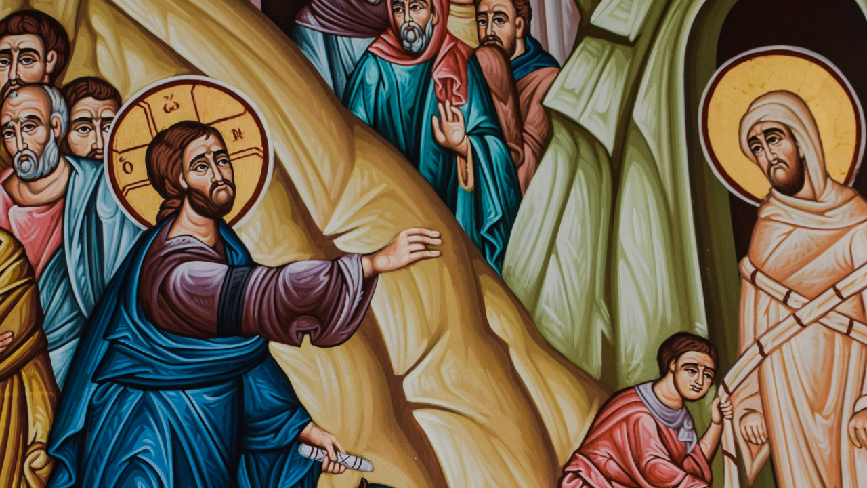
Read Gospel and Passages from Baptised and Sent
John 11:3-7,​17,​20-27,​33-45 The Raising of Lazarus

Slide 28
Reflect
Pause for silent reflection.
Share what is staying with you from these readings.
Listen to each other to understand.
In light of this, in what way does my baptism give me new life?
Make sure everyone gets a chance to share their thoughts

Slide 29
Respond in Action
Having listened to what each person has to say and decided on what what way/s is your parish welcoming and inclusive, consider the following question:
What concrete steps or actions can I/we take to renew my baptism this Easter?
Find ways to realise these action points in your life and community.

Slide 30
Closing Prayer
Gracious God,
We thank you for journeying with us and for all that has been shared.
Help us to remember that we are all Baptised and Sent and give us the courage and energy to make a difference in our world.
Through Christ our Lord
Amen

